Slide 1
Portfolio

Slide 2
Technical Communication Projects

Slide 3
HTML & CSS Website
The following link is to an HTML and CSS website that was created for a Digital Technologies class in which my pets are raising money for animal shelters.
Luessen Fundraising

Slide 4
Technical Communication: A History
How a Profession was Established
Technical communication is the sharing of information about how things work. This is a brief look at technical communication over time.
Technical Communication: A History

Slide 5
Research Projects

Slide 6
Red River Valley Psychology Conference, 2008
A poster presentation from the 2008 Red River Valley Psychology Conference.
Attraction & Repulsion Poster, 2008

Slide 7
Red River Valley Psychology Conference, 2008
A paper presentation from the 2008 Red River Valley Psychology Conference.
Attraction & Repulsion Paper, 2008

Slide 8
Art Projects

Slide 9
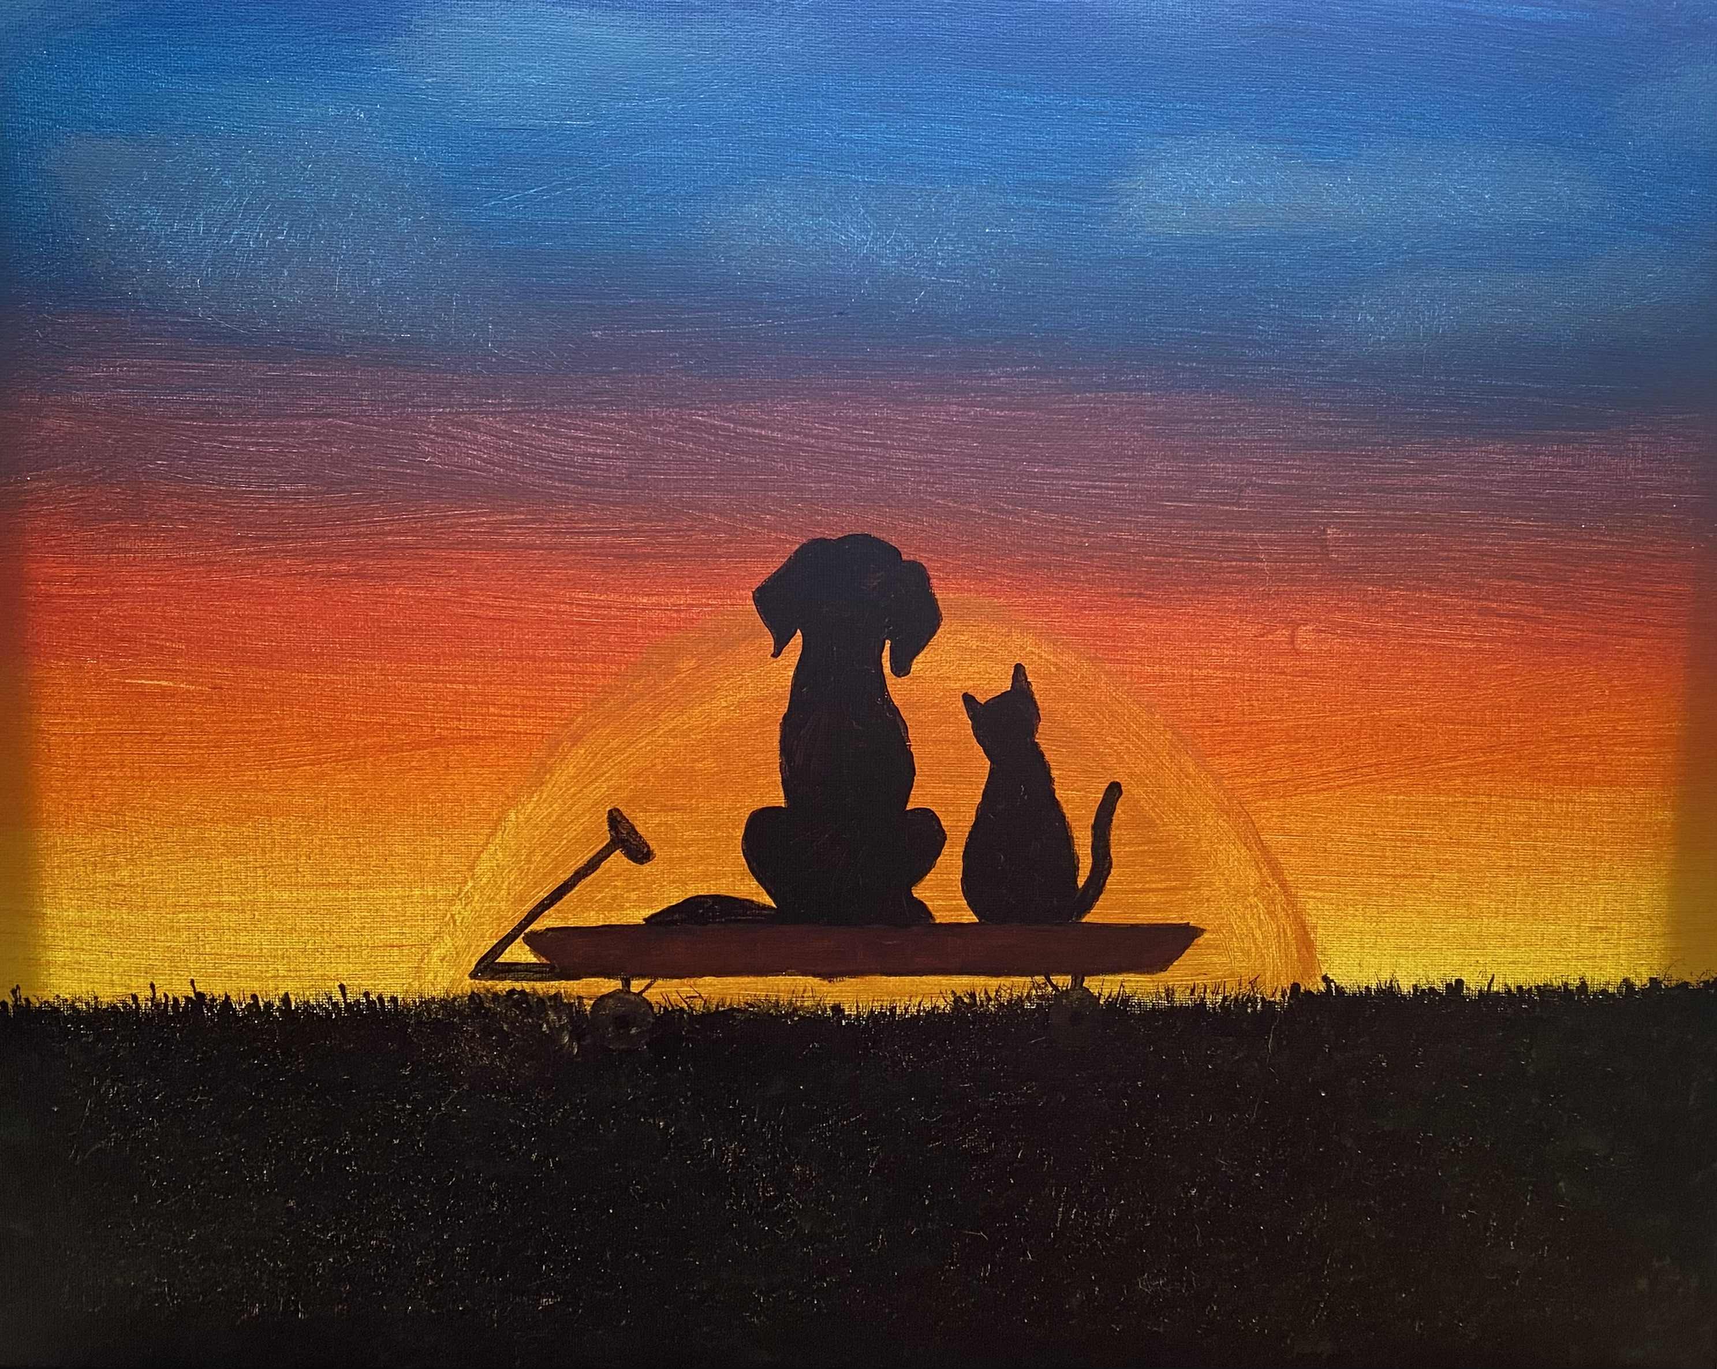
Acrylic Painting
This cat and dog watching sunset in a wagon painting is acrylic on canvas.
Acrylic Pet Painting

Slide 10
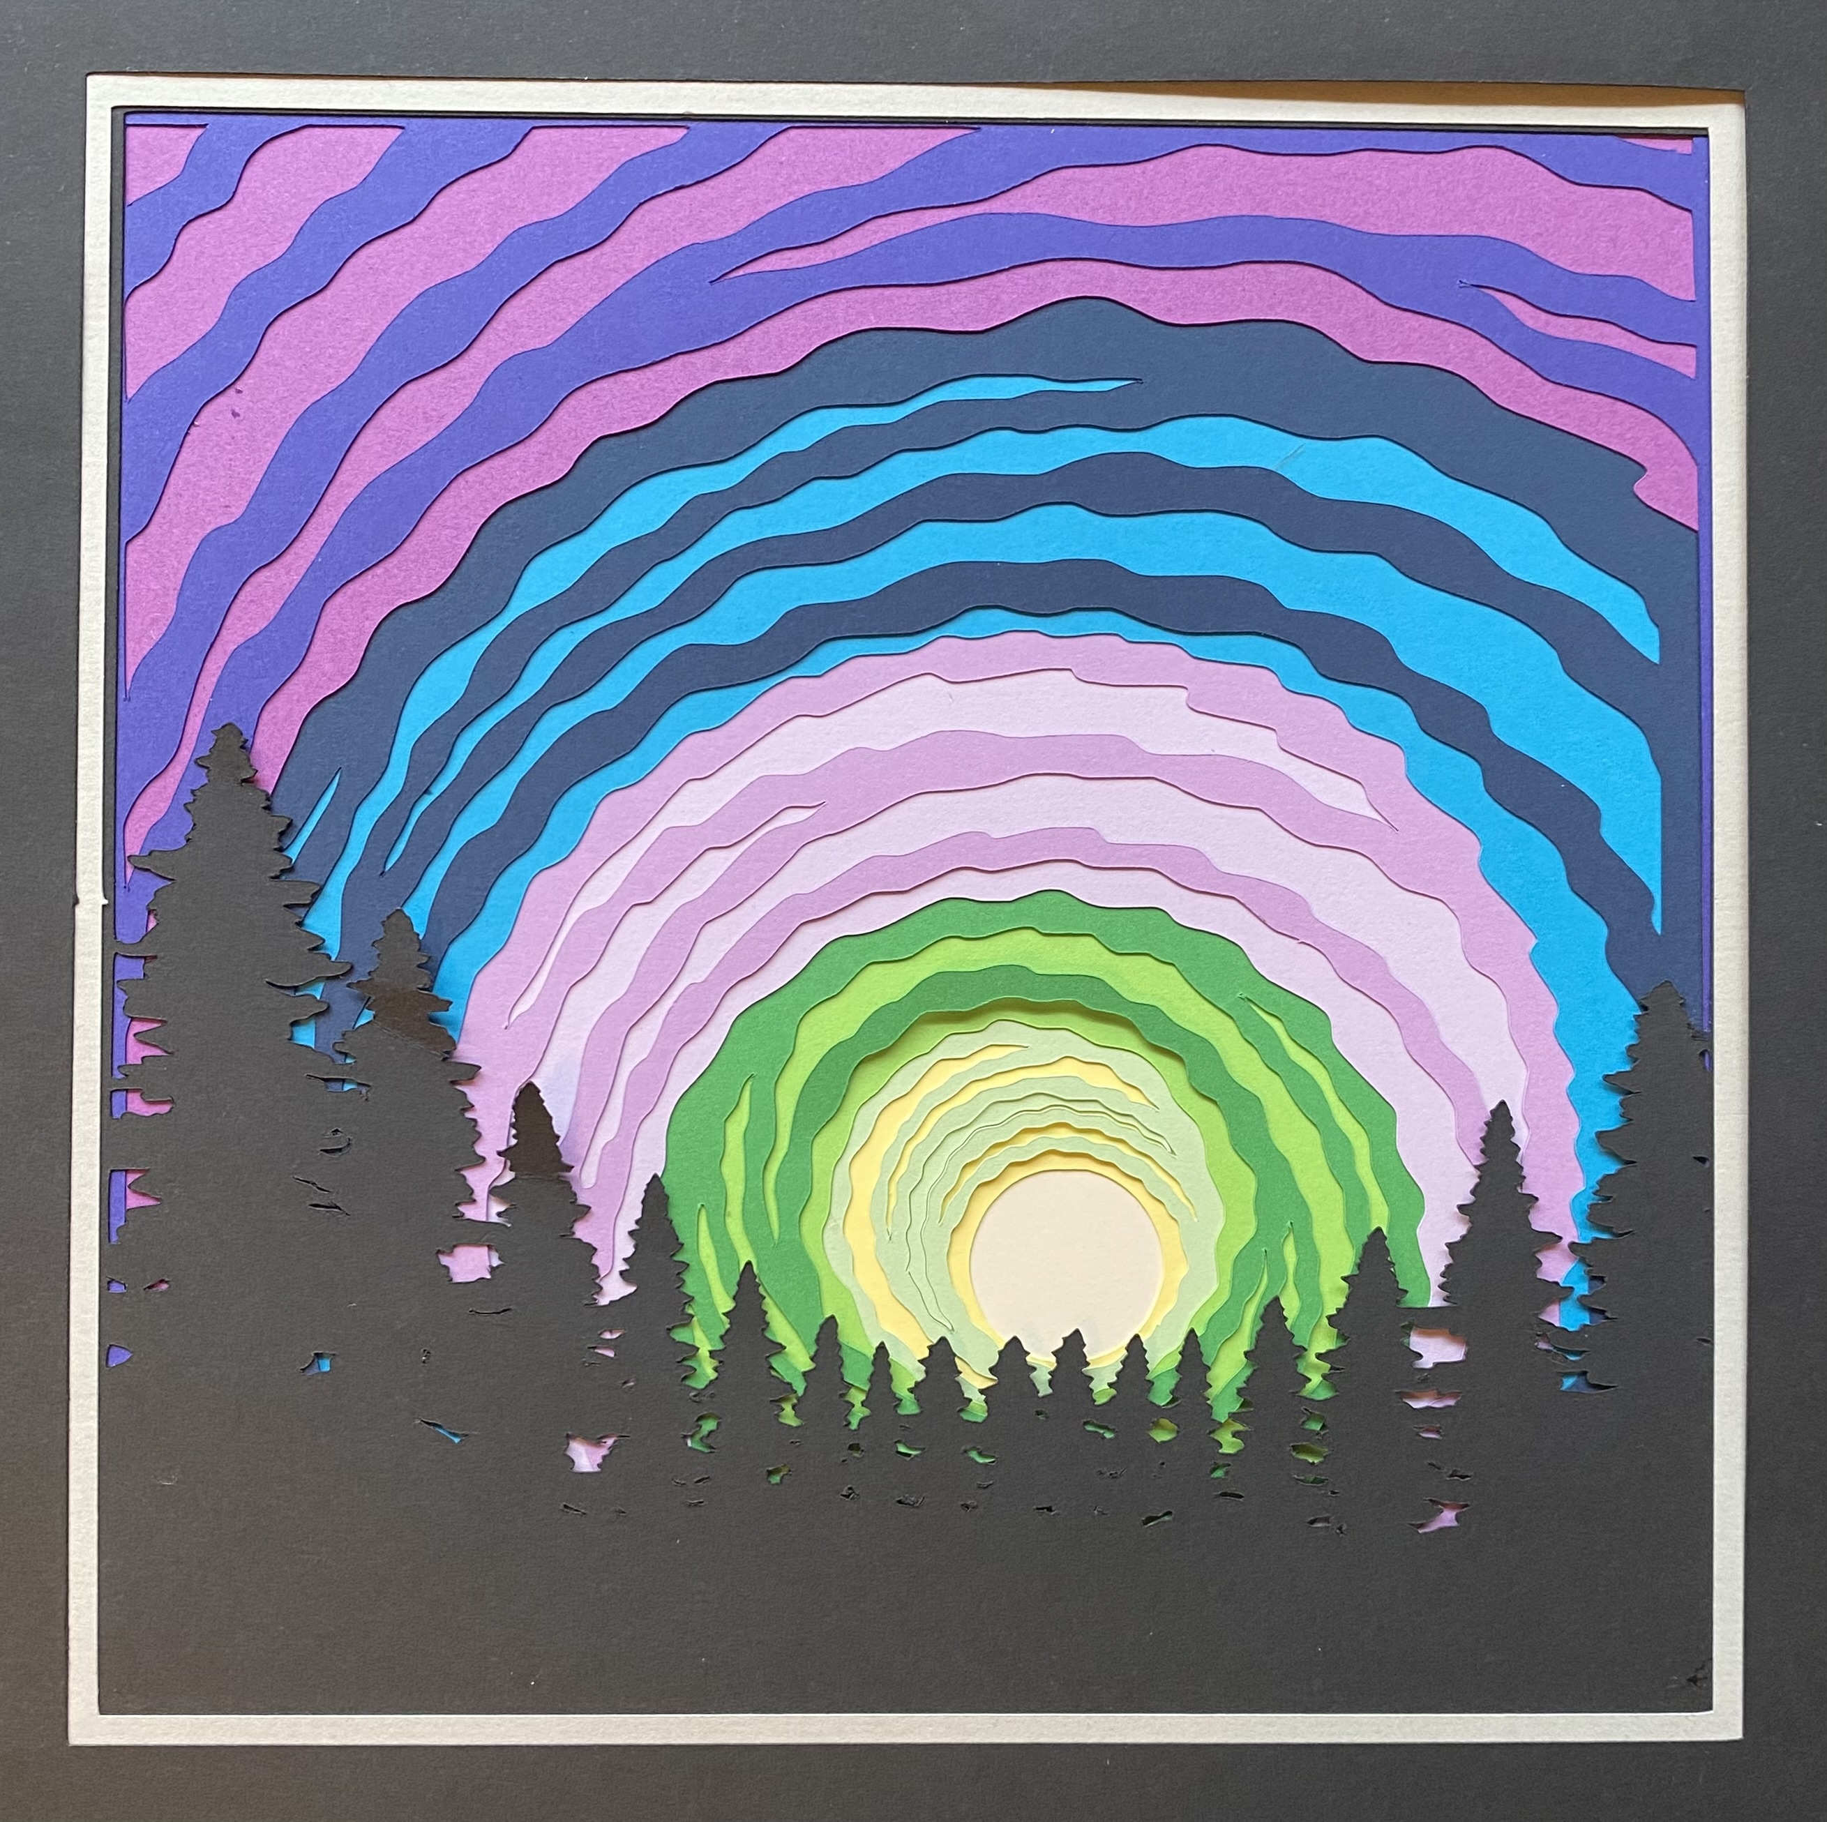
Cricut Layered Shadowbox
This shadowbox image of the northern lights from the forest is a Cricut creation using layered cardstock.
Cricut Northern Lights Shadow Box

